Slide 1



PATH TO SAVE OUR COUNTRY
Presented By
VICTOR

Slide 2

Members of VICTOR Team
Mr.Attapong Chaidhiravedj
Mr.Promchai Choosaeng
Mr.Waranthorn Chansawang

Slide 3
Discuss about the topic of our game
Design map
PROCESS
Insert materials
Writing the scripts
Test the game

Slide 4

SOCIAL PROBLEMS IN THAILAND
Poverty Problem
Crime Issues
Drug Problem
Environmental Problems

Slide 5
THEME
We want to encourage people who play this game to see the importance of garbage separation. This is not difficult. Anyone can do it. By disposing of waste, there are many benefits, such as saving on waste, reducing energy consumption and resources by recycle glass, paper, metal, plastic, etc. or help to reduce pollution to the world

Slide 6
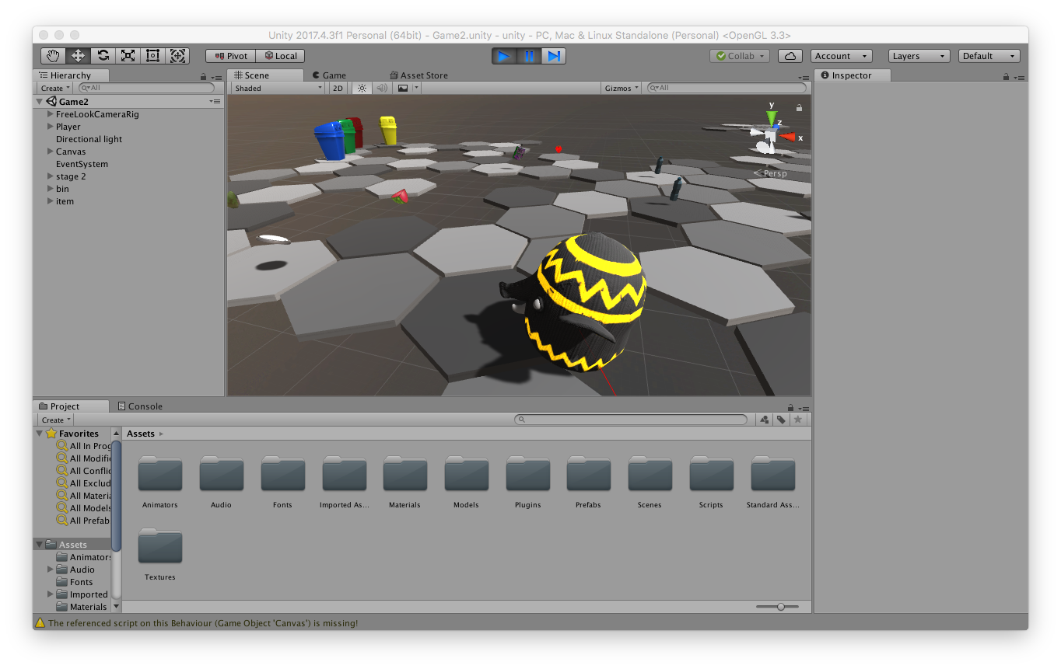
ORIGINALITY
Disposing of garbage in this game is not different from real life because when we dispose of garbage we need to walk to the bin by ourselves, so in this game we will control the character name "Hellephant” to pick up the garbage that on the path for dispose in bin by type of garbage and colors of bins. If dispose wrong bin the scores will be deducted unlike destroy the Earth but if dispose correct bin the scores will be increase, so this game can instill consciousness to separate garbage before disposing and dispose the garbage into the bin.

Slide 7
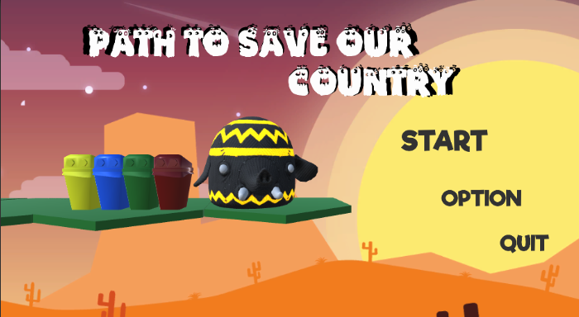
GAME

Slide 8
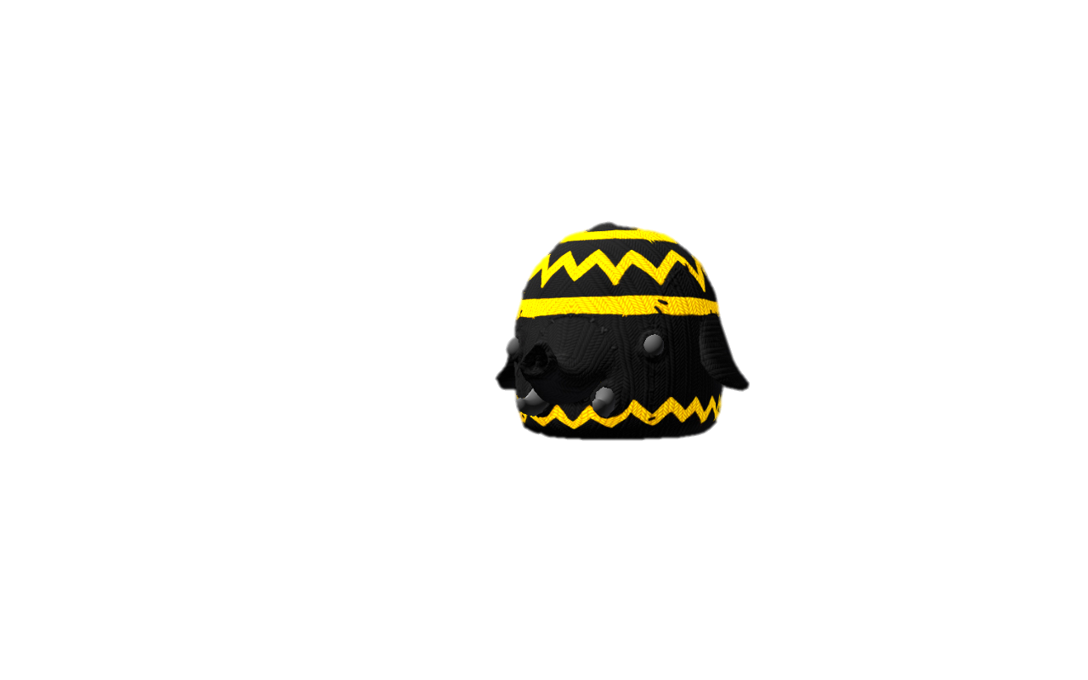
HELLEPHANT
The elephant who wants to solve the garbage problem by separate the garbage before dispose into the bin.

Slide 9
TYPES OF BIN
BIODEGRADABLE
HAZARDOUS
RECYCLE
GENERAL

Slide 10

THANK YOU

